Slide 1
Flutter Application Showcase
GRAND CHAMPION - Exemplary animation and productivity
BEST APP EXECUTION - Productive and usable app
BEST VISUAL BEAUTY - Beautiful User Interface and animation

Slide 2

Cross Platform Mobile App Development with Flutter and Firebase

Slide 3




Jeryl Donato Estopace
- Pursued my passion in web and mobile development in 2016.
- Currently working as a Technical Support Engineer for a Cloud-based ERP Company.
- Started learning Flutter since v1.0.0 release last December 2018.
github.com/JerylDEv
facebook.com/JerylDEvFlutter
Search for “JerylDEv”

Slide 4
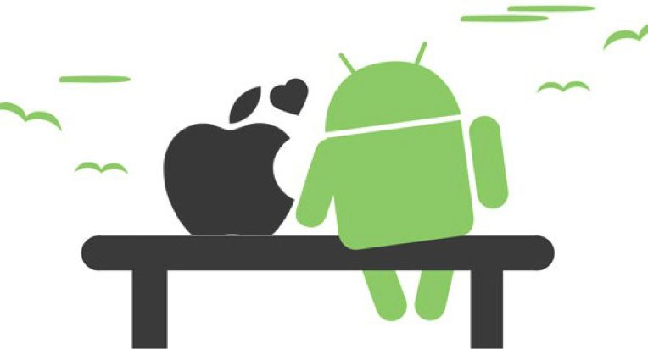
Mobile Platforms

Slide 5
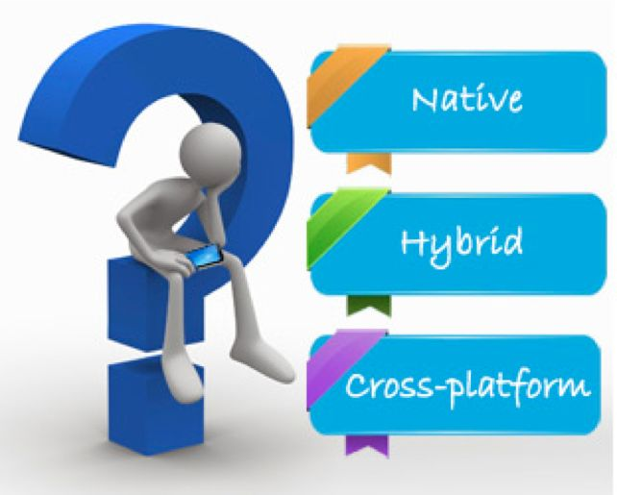
Mobile Development Approaches

Slide 6




Native Approach
Swift
Kotlin

Slide 7
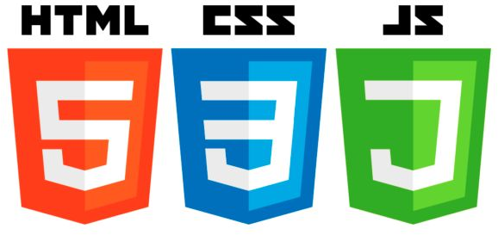
Hybrid Approach

Slide 8



Hybrid Approach

Slide 9





Cross-Platform Approach
Google Flutter Dart
JavaScript
C#
JavaScript
JavaScript or TypeScript

Slide 10
So what is Flutter?
Flutter is Google’s UI toolkit for building beautiful, natively compiled applications for mobile, web, and desktop from a single codebase.

Slide 11

What makes Flutter unique?
Compiles to Native Code (ARM Binary code)
No reliance on OEM widgets
No bridge needed

Slide 12


What language is Flutter built with?
+
=

Slide 13

What is Dart?
Open-source web programming language developed by Google.
Class-based, single-inheritance, object oriented language with C-style syntax.
Supports interfaces, abstract classes, reified (concrete) generics, and optional typing and strong typing
One language to rule them all..

Slide 14
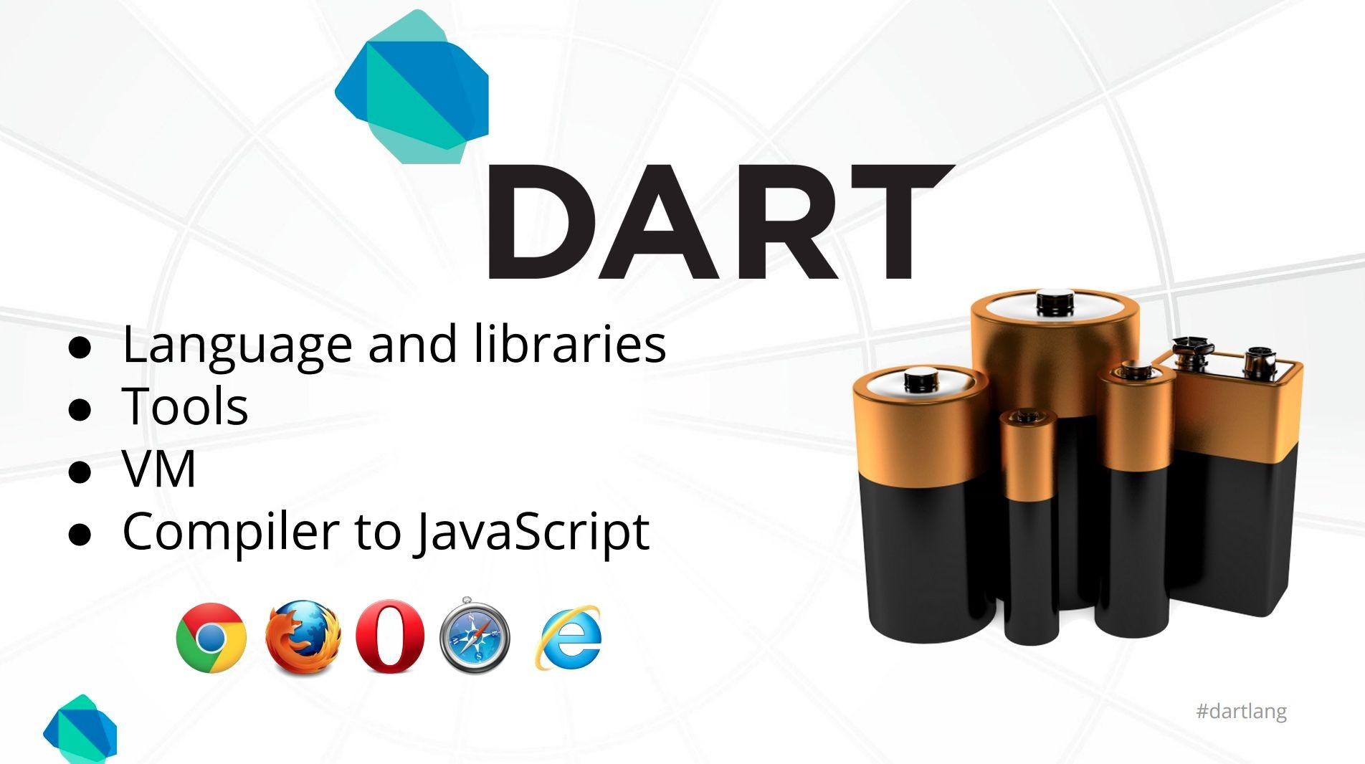
What is Dart?

Slide 15
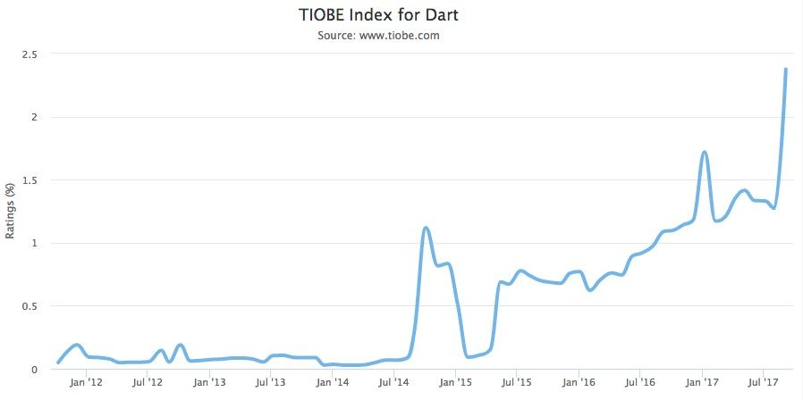
What is Dart?
https://www.tiobe.com/tiobe-index/dart/

Slide 16
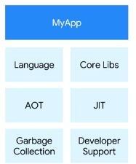
What is Dart?

Slide 17

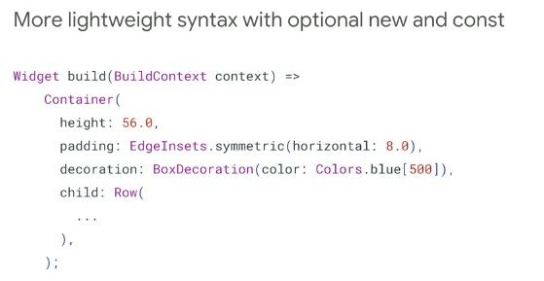
What is Dart?
https://www.dartlang.org/dart-2

Slide 18
Who use Dart?
Google AdWords
Google Fuchsia
Google Fiber
AdSense performance reports
Mandrill
AdWords for video
Google internal sales tool
Google internal CRM
Adobe
https://www.dartlang.org/community/who-uses-dart

Slide 19

Let’s write some Dart code!

Slide 20
How Flutter works ?

Slide 21
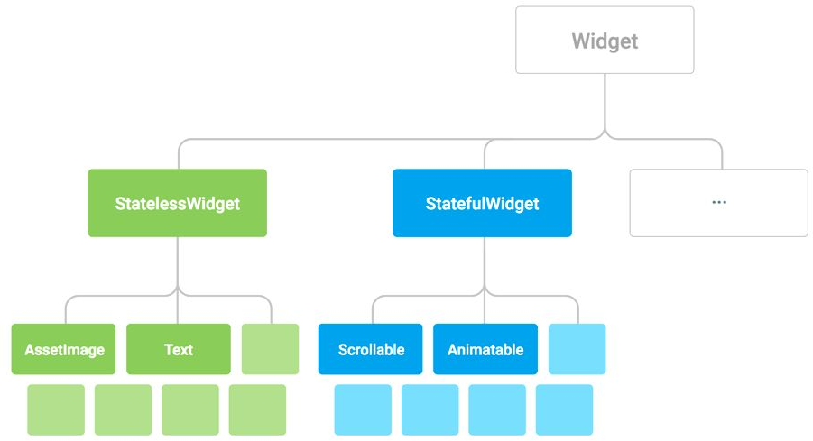
Everything is a Widget

Slide 22
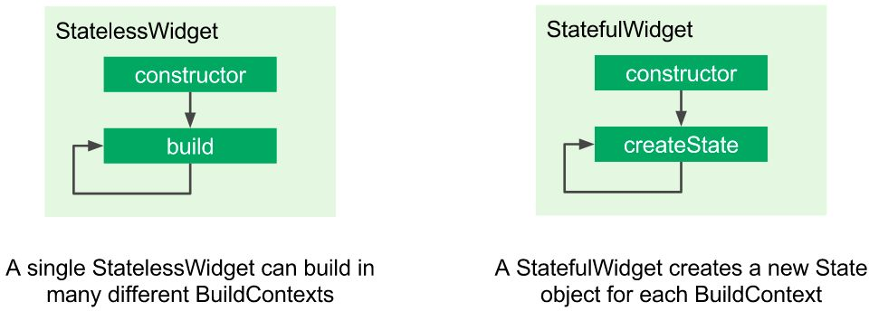
StatefulWidget vs. StatelessWidget

Slide 23
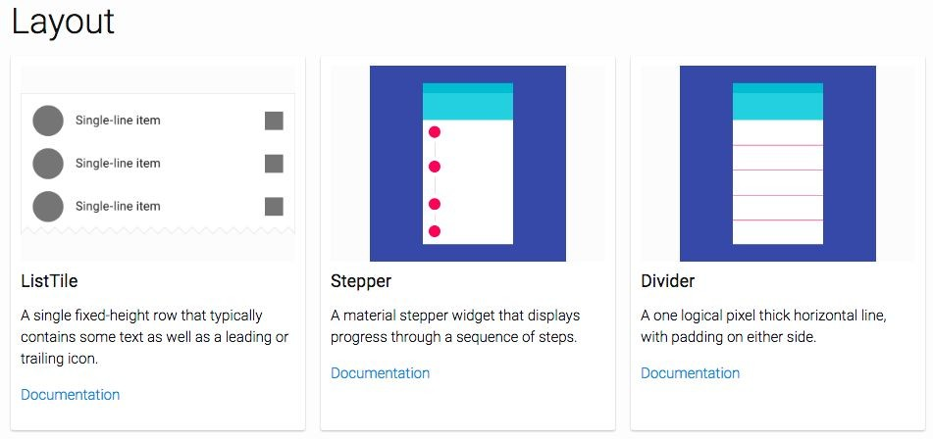
https://flutter.io/widgets/widgetindex/

Slide 24
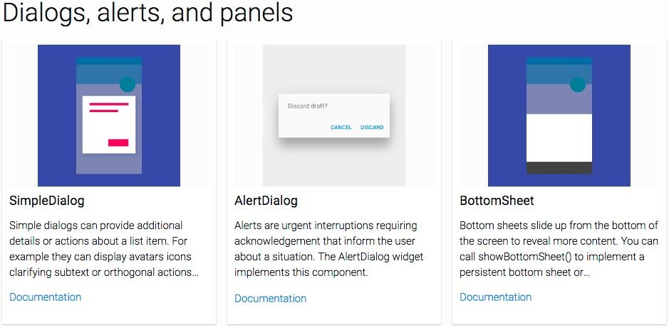
https://flutter.io/widgets/widgetindex/

Slide 25
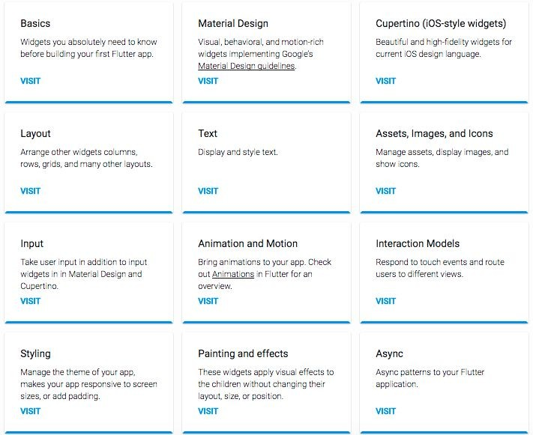
https://flutter.io/widgets/

Slide 26
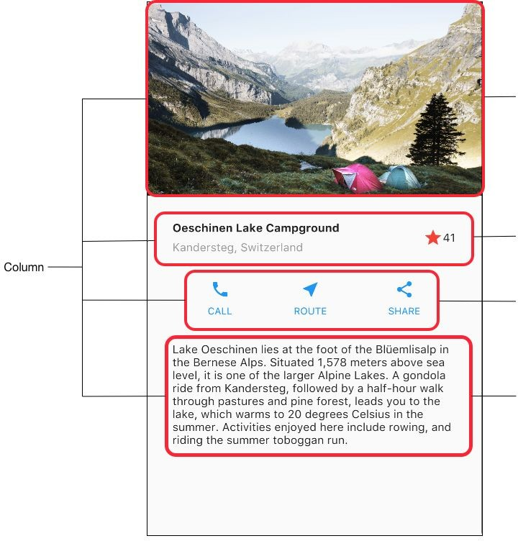
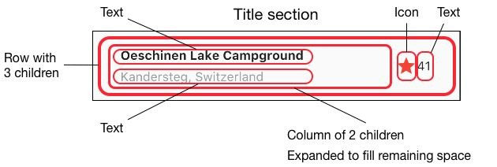
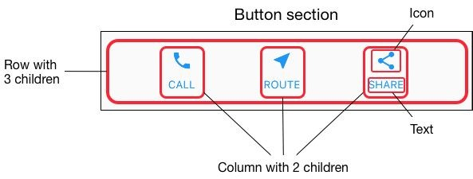
Rows and columns

Slide 27
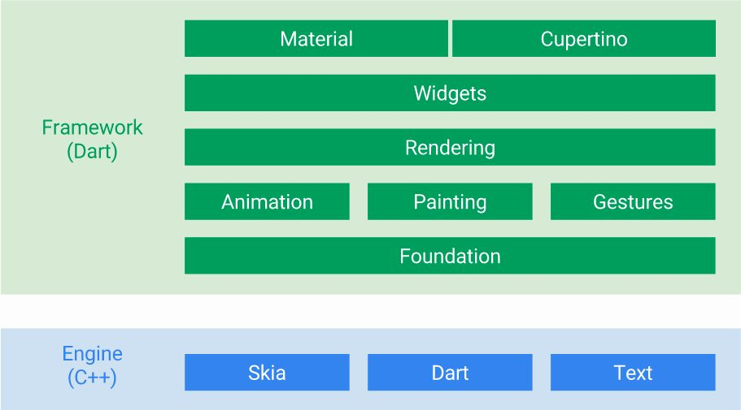
You can customize everything in green

Slide 28
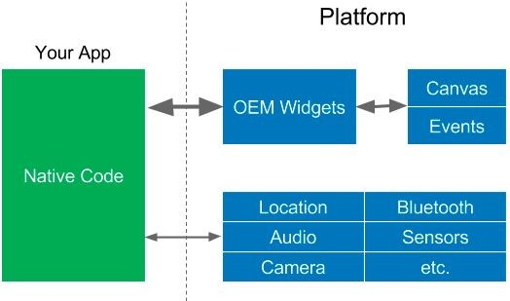
OEM SDKs

Slide 29
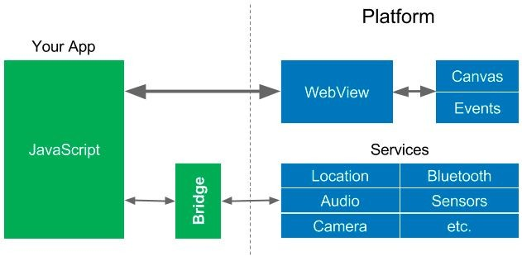
WebViews

Slide 30
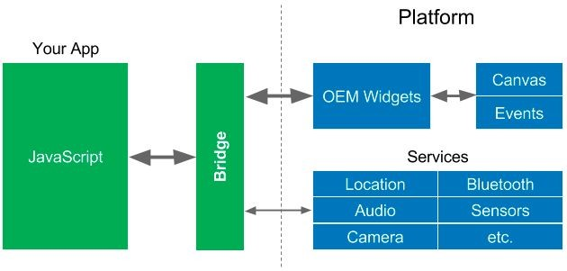
Reactive Views

Slide 31
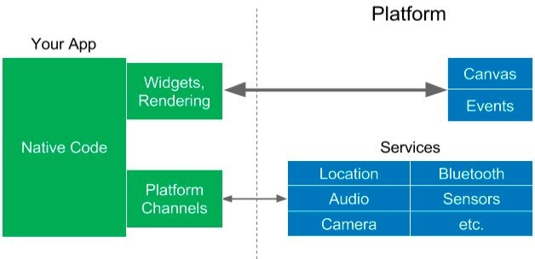
Flutter

Slide 32
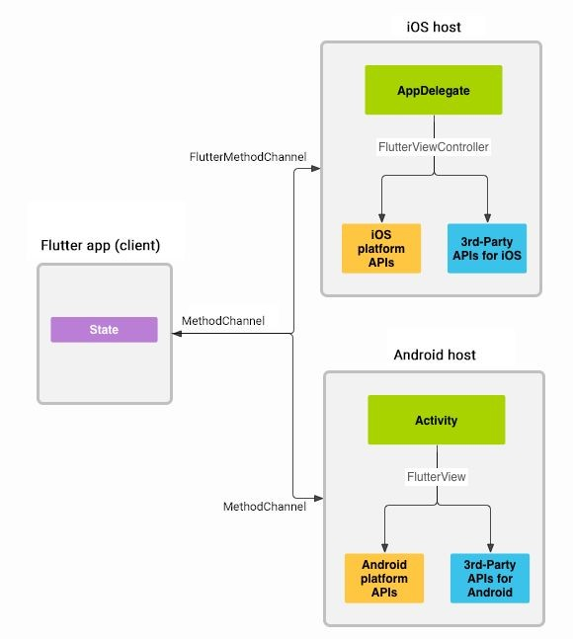
Platform channels
Flutter
https://flutter.io/platform-channels/

Slide 33
Let’s make a
Flutter App!

Slide 34
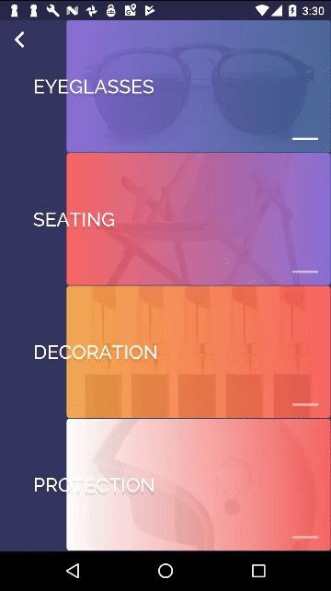
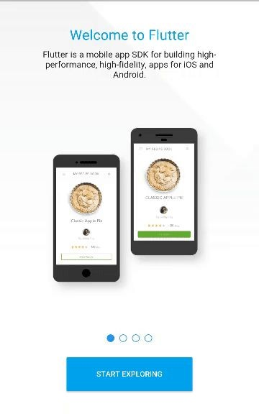
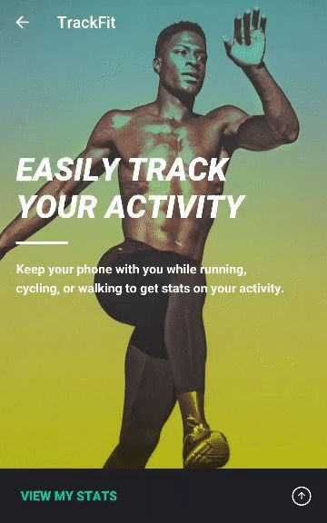
Great looking and fast Widgets

Slide 35
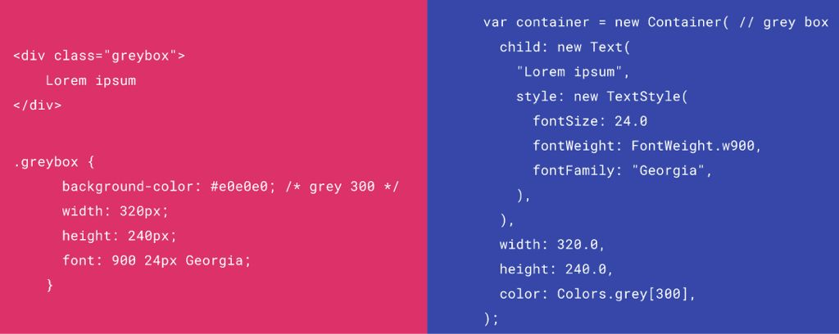
HTML/CSS Analogs in Flutter

Slide 36
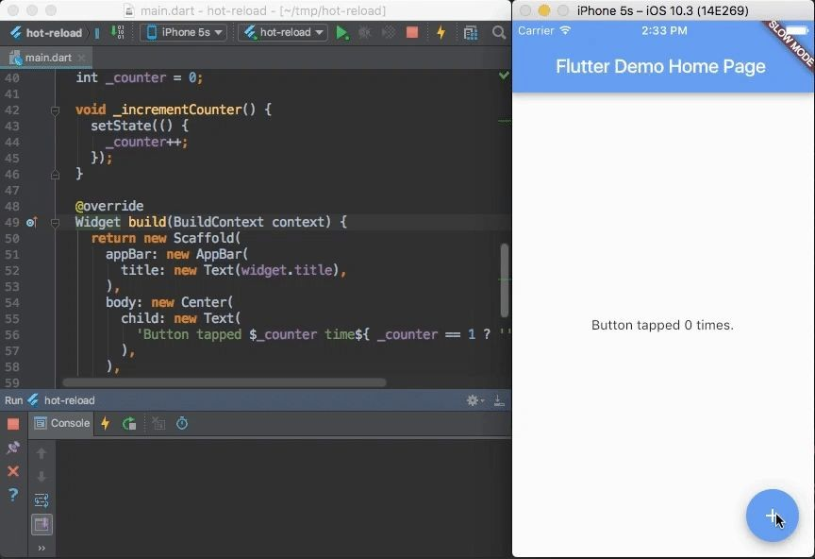
Hot Reload

Slide 37
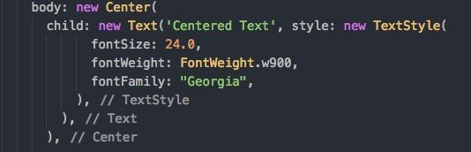
No global layout system
Local layouts: Every Widget defines it’s own layout. No need to tell the parent that it’s children are supposed to be centered.

Slide 38
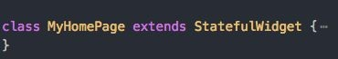
Customizing and extending Widgets
Flutter’s Widget system was designed to be easily customizable
Composition: Widgets are built out of smaller widgets that you can reuse and combine in novel ways to make custom widgets

Slide 39
With Flutter no limit to your imagination.
Flutter

Slide 40
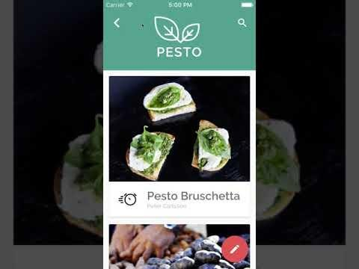
With Flutter no limit to your imagination.

Slide 41
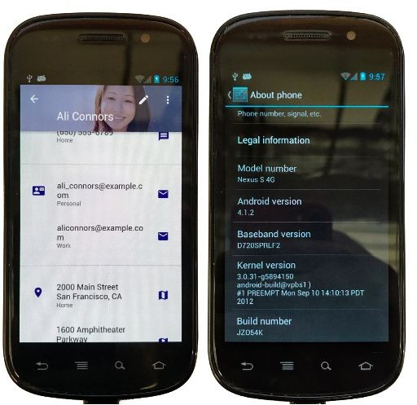
Consistent Material Design (or your design) on phones made way before Material Design existed

Slide 42





IDE Support ?

Slide 43
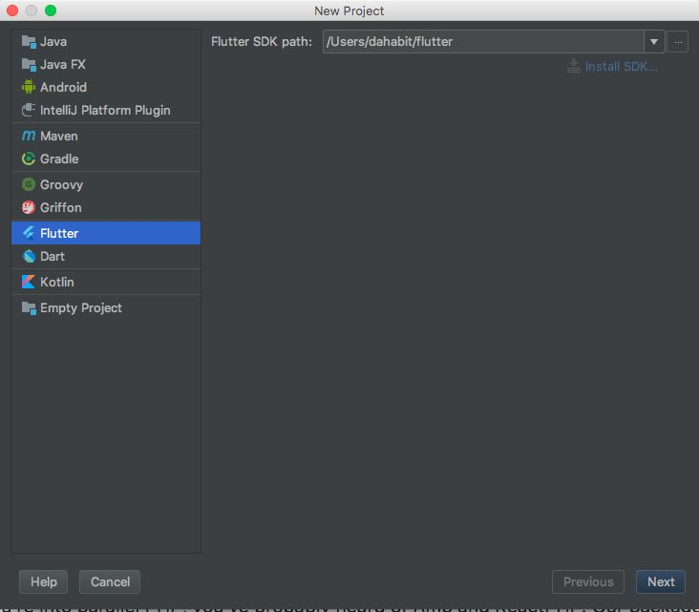
IDE Support ?

Slide 44
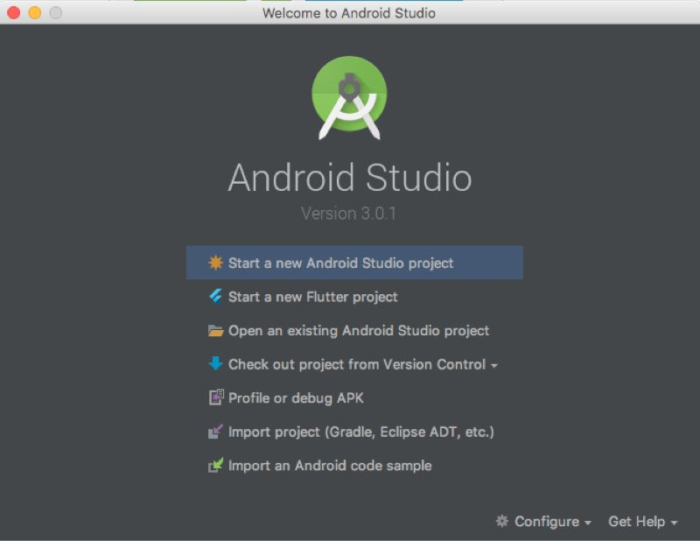
IDE Support ?

Slide 45
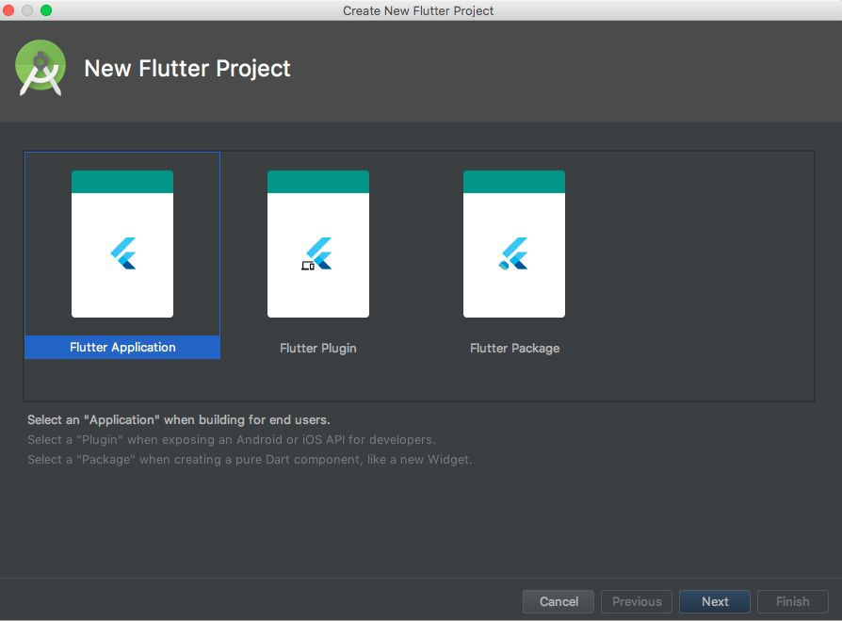
IDE Support ?

Slide 46
IDE Support ?

Slide 47
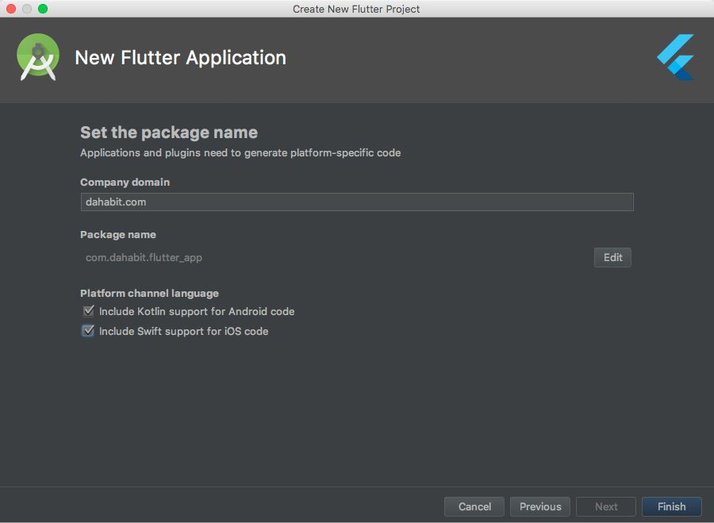
IDE Support ?

Slide 48
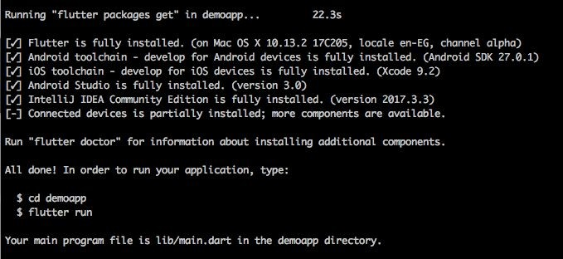
Terminal ?
$ flutter create demoapp

Slide 49
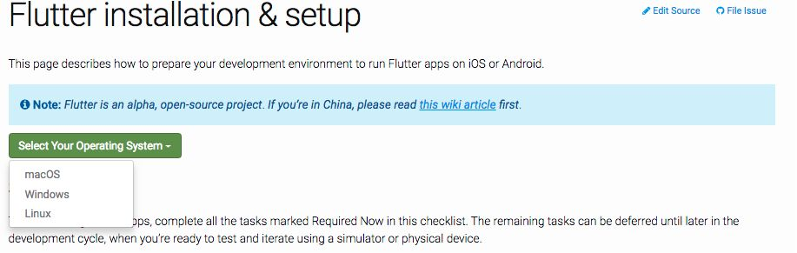
How To install ?
https://flutter.io/setup/

Slide 50
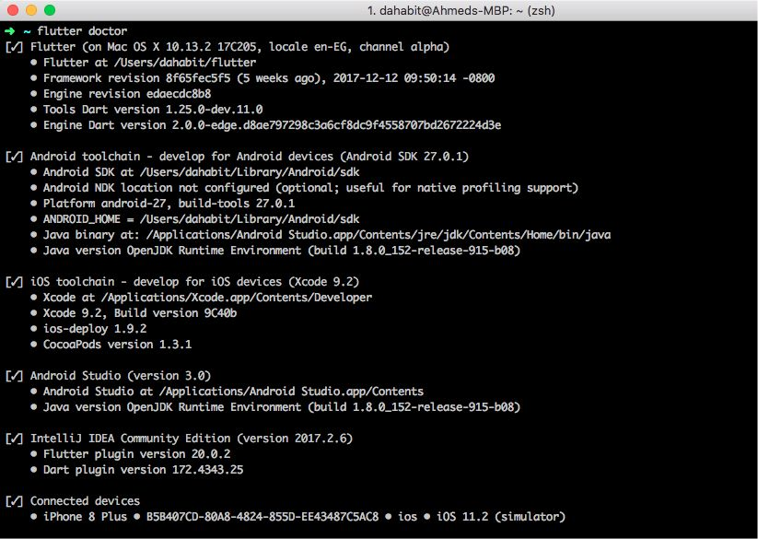
Easy Check !
$ flutter doctor

Slide 51
The Flutter Community has a website showing a list of apps built with Flutter: https://itsallwidgets.com

Slide 52
Demo

